Slide 1
Staged Unit Operations
Team 7: Gianna Borgese, Justin Graves, Matthew Jarvis, Kiana Yip

Slide 2
Absorbing and Stripping Columns Purpose
Absorption: use liquid absorbent (MSA) to selectively remove components from gas mixtures
Absorption column: removes impurities, contaminants, pollutants, or catalyst poisons
Stripping: use vapor absorbent to selectively remove components from liquid mixtures
Coupled with absorption columns to recover and purify gas absorbent

Slide 3
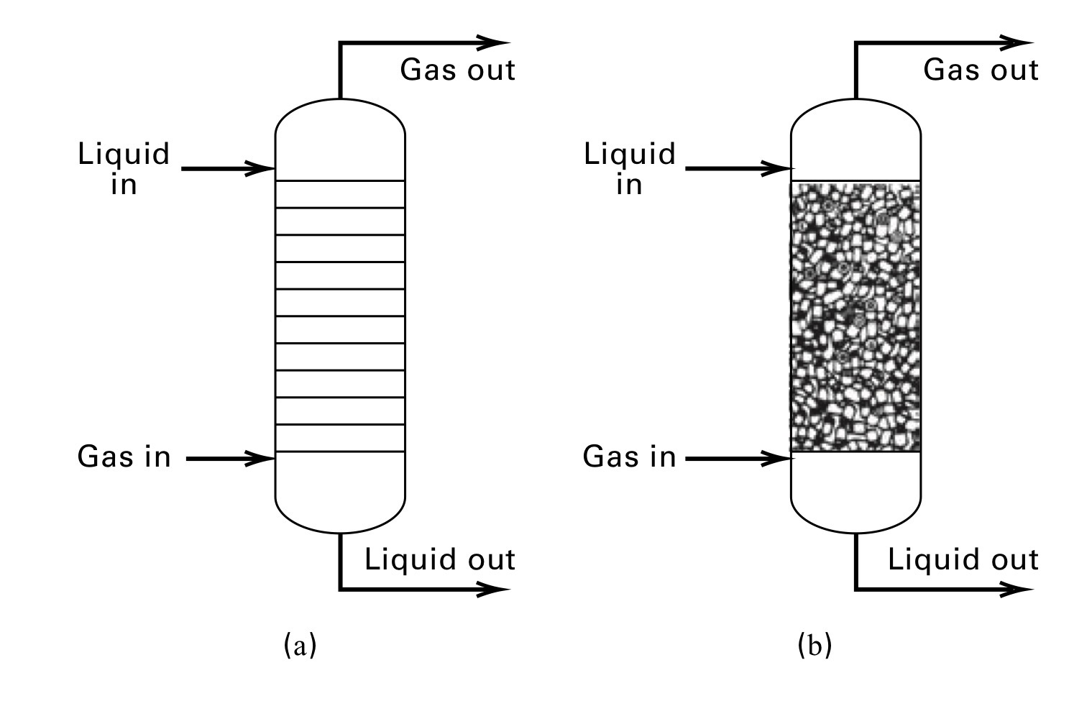
Process and Equipment
Trayed and packed columns
Physical and imaginary trays
Each tray represents an equilibrium stage
Goal: maximize the gas-liquid contacts on the tray
Po-Yen Chen, “Introduction to Separation Processes” (Lecture 1, CHBE426, University of Maryland, College Park, April 30, 2023).

Slide 4
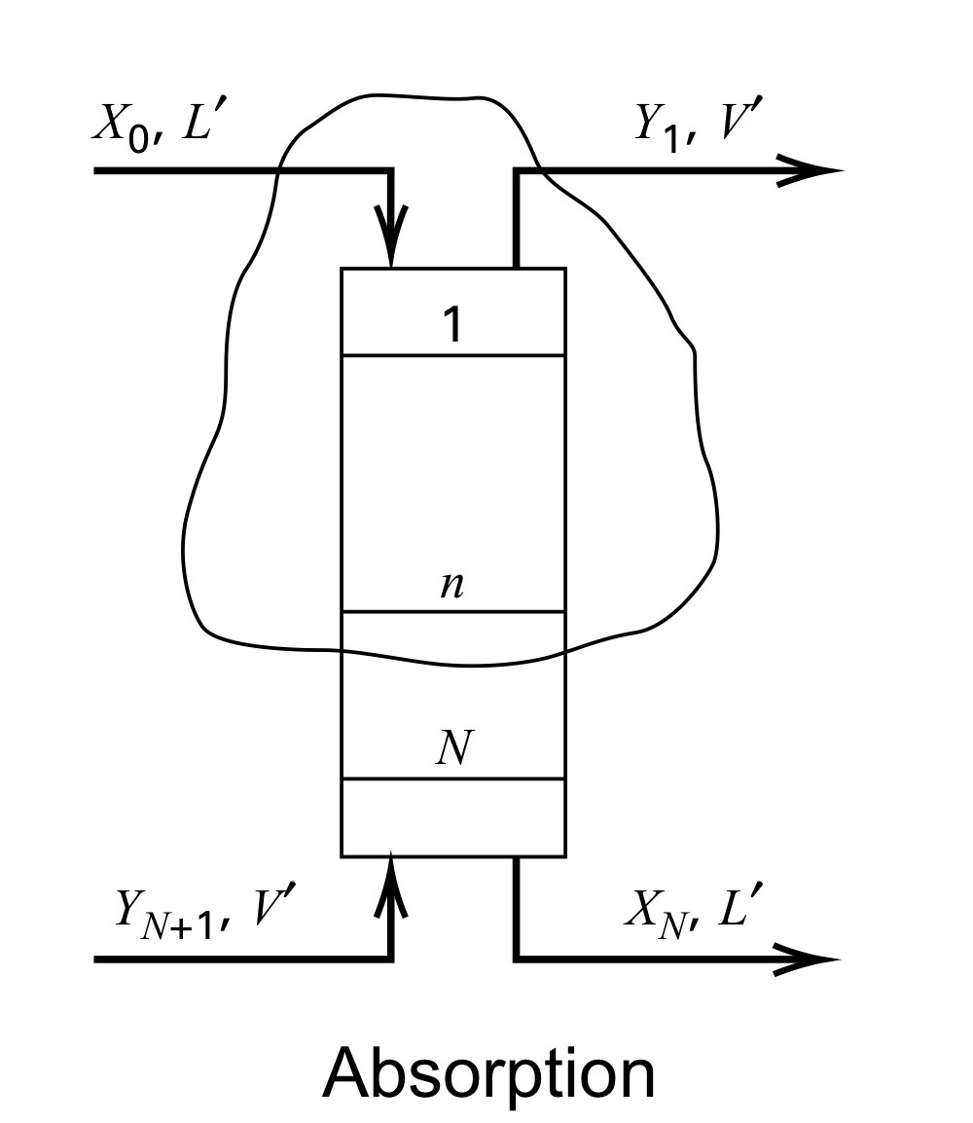
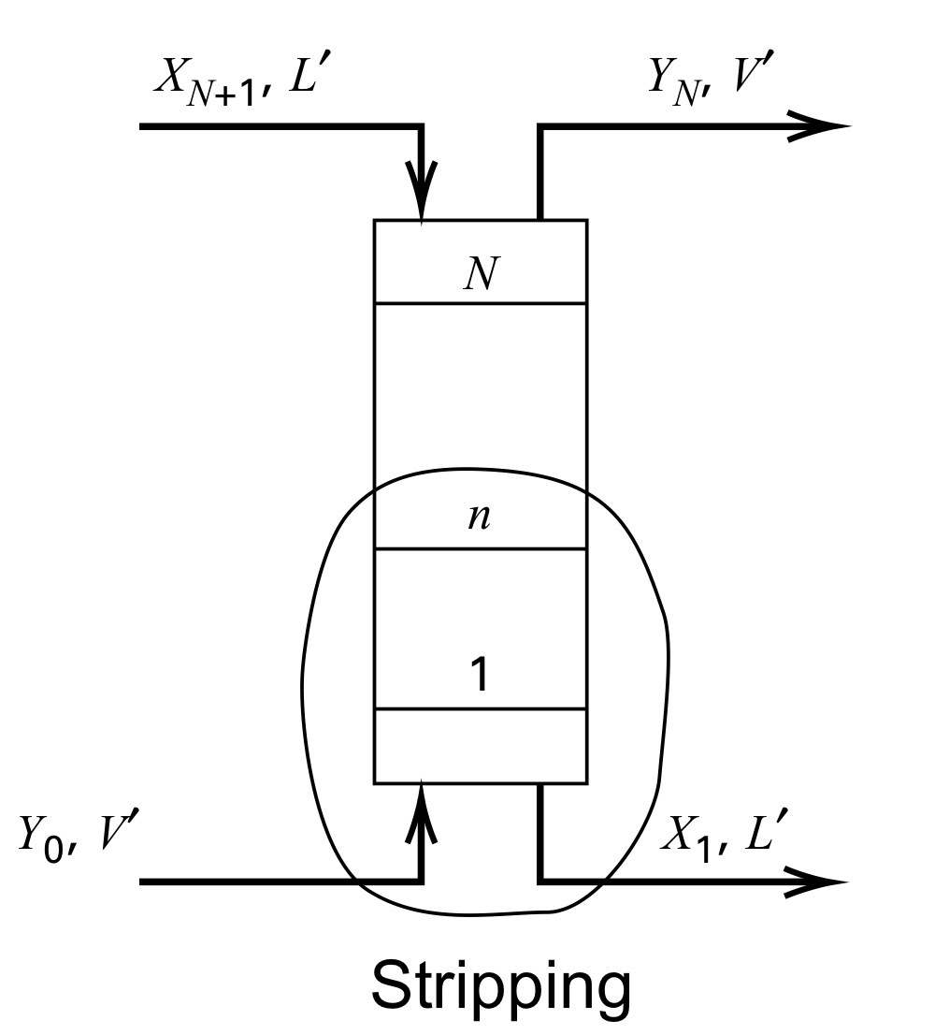
Process and Equipment
Stages are numbered from the location absorbent goes in
Numbered from top where liquid goes in
Numbered from bottom where gas MSA goes in
Po-Yen Chen, “Introduction to Separation Processes” (Lecture 1, CHBE426, University of Maryland, College Park, April 30, 2023).

Slide 5
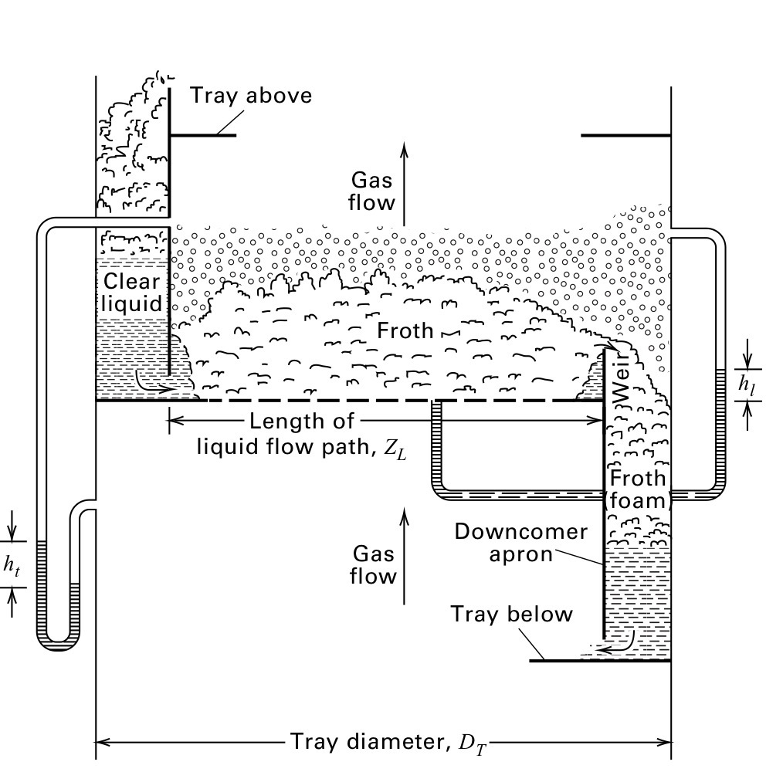
Gas-Liquid Contact on a Tray
Liquid carries no gas/bubbles downwards
Gas carries no liquid upwards
No dripping of liquid
Froth is highly desirable
Po-Yen Chen, “Introduction to Separation Processes” (Lecture 1, CHBE426, University of Maryland, College Park, April 30, 2023).

Slide 6
Absorbing / Stripping Column Mathematics

Slide 7
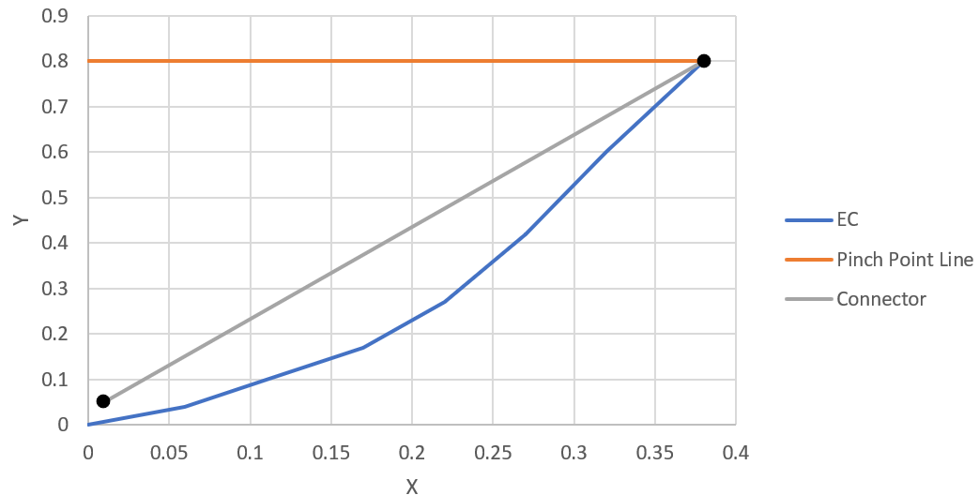
Minimum MSA Flow Rate
Plot XY Diagram
Draw horizontal line @ inlet molar ratio of feed
Draw a point at inlet molar ratio and desired outlet molar ratio of MSA
Connect this point with the pinch point
Lmin = V * Slope of line
Pinch Pt
(X0,Y0)

Slide 8
Packed Column Height Calculation
y* = K*x
All terms should be known, making column height determinable
Requires lots of equilibrium knowledge (NIST Chemistry Webbook)

Slide 9
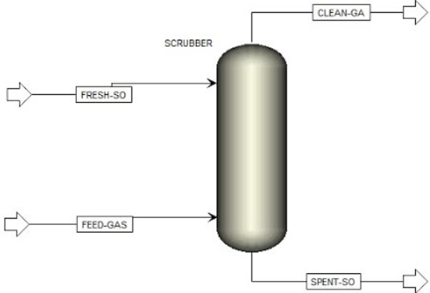
What Now?
Knowing the minimum flow rate or column height allows for effective first draft modeling
These values can be adjusted slightly and plugged into Aspen
Makes design and troubleshooting easier
Removes the need for guess and check and allows for informed decision making
https://www.youtube.com/watch?app=desktop&v=UvIu2YG1rp8

Slide 10
Distillation

Slide 11
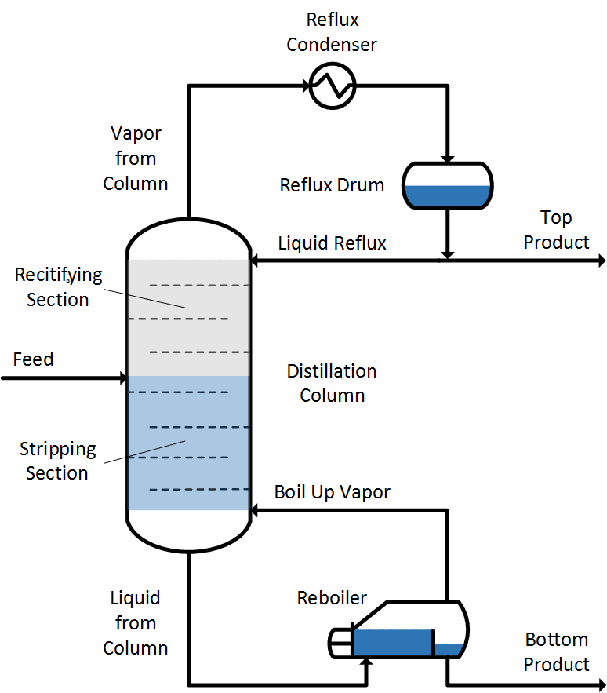
Main Components of a Distillation Column
Vertical column or tower
Internal trays or packings to enhance separation
Reboiler
Partially vaporizes the liquid
Condenser
Condenses the vapor leaving top of column
Reflux drum
Collects condensed liquid and recycles back into column
Rectifying Section
Concentrates the lighter component in the vapor phase
Stripping Section
Concentrates the heavier component in the liquid phase
https://neutrium.net/unit-operations/distillation-fundamentals/
Notes:
https://www.comsol.com/blogs/calculating-thermodynamic-properties-for-liquids-and-gases/
https://www.wermac.org/equipment/distillation_part1.html
https://doc.comsol.com/6.0/doc/com.comsol.help.models.chem.distillation_column/models.chem.distillation_column.pdf

Slide 12
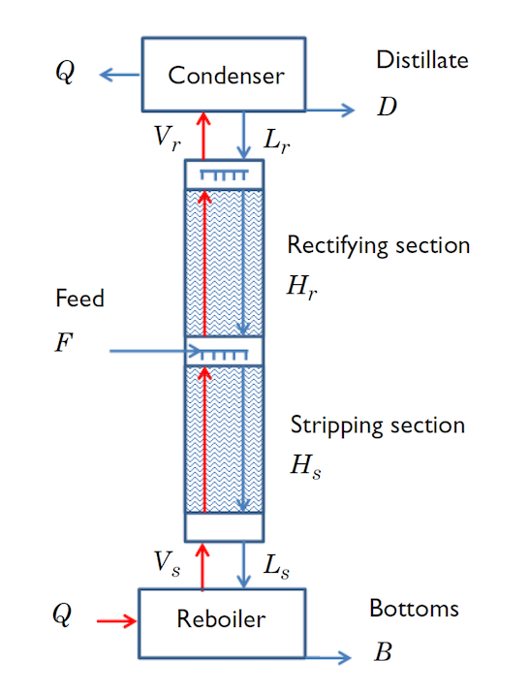
Modeling a Distillation Column
Binary distillation with a saturated liquid feed of water and ethanol fed into the column between the stripping and the rectifying sections.
Goal: Determine the column height required to separate a feed of known flow rate and composition into a specified purity.
https://www.comsol.com/blogs/calculating-thermodynamic-properties-for-liquids-and-gases/

Slide 13
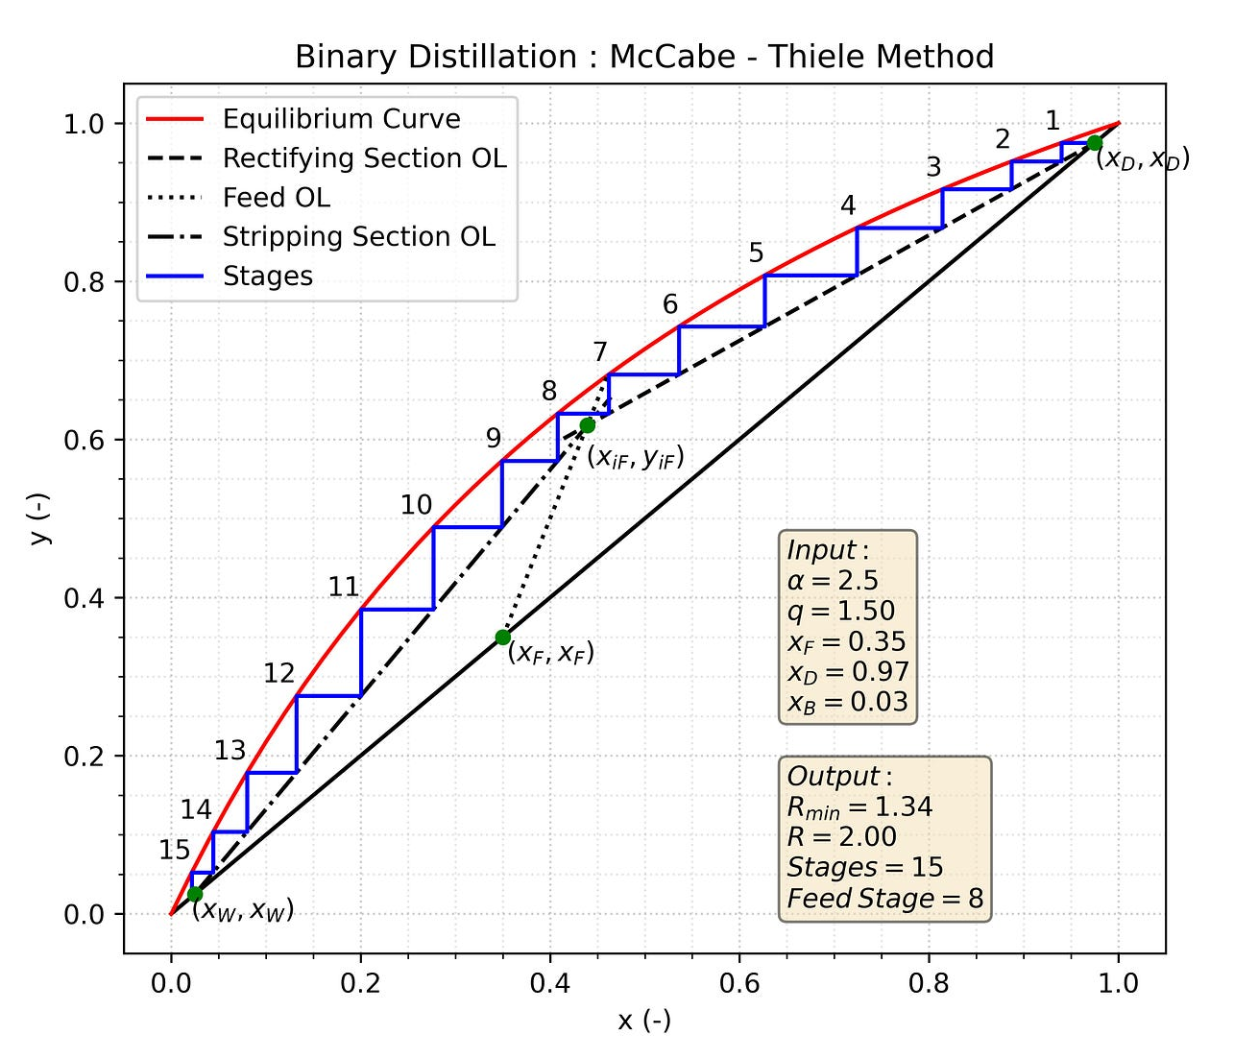
Binary Distillation Numerical and Graphical Methods
https://medium.com/@pukumarathe/mccabe-thiele-method-in-python-791e5760b6b1
Notes:
possible non-aspen simulation? https://tlk-energy.de/en/phase-diagrams/mccabe-thiele or search McCabe-Thiele Simulation
McCabe Thiele Simulation in Python: https://medium.com/@pukumarathe/mccabe-thiele-method-in-python-791e5760b6b1
McCabe Thiele is a graphical method that can be used to analyze distillation columns with two components. It can help us visualize multistage distillation. With the McCabe-Thiele method, we can find the number of stages, minimum number of equilibrium stages, minimum reflux ratio (reflux/distillate ratio), optimal feed location, and the heat duties of the condenser and reboiler.

Slide 14
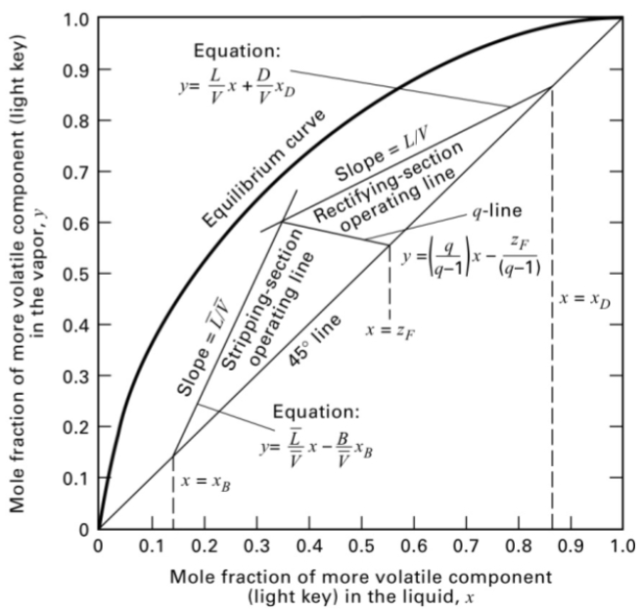
Five Construction Lines of McCabe Thiele
Equilibrium Curve
45° line
Rectifying operating line - distillate
Stripping operating line - bottoms
q-line feed line
Seader, J.D.; Henley, H.J.; Roper, D.K., Separation Process Principles, 4th ed.; Wiley
Notes:
physical part should describe different between rectifying section and stripping
MT Assumptions: light key and heavy key components have similar enthalpies for evaporation, neglect sensible heat change and mixing heat balance for the LK ad HK
Heat loss of a distillation tower is negligible. Constant molar overflow

Slide 15
Operating Line Equations
Rectifying Section Operating Line
Stripping Section Operating Line
where R is the reflux ratio, V_{B} is the boil up ratio x_{D} is mole fraction of light key in the distillate, and x_{B} is the mole fraction of light key in the bottoms
Notes:
If you are given purity for the distillate and bottoms product, these equations along with simple mass balances for the overall distillation and the lightkey component, can be used to construct a foundation for a suitable distillation column.

Slide 16
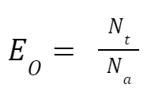
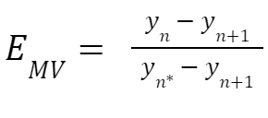
Performance Data Equations
Overall Column Efficiency
Individual Tray Efficiency
where E_{O} is overall column efficiency, E_{MV} is the Murphree Vapor efficiency, N_{t} is the theoretical number of equilibrium stages, N_{a} is the actual number of stages, y_{n*} is the ideal vapor fraction at n tray, and y_{n} is the real vapor fraction at n tray

Slide 17
COMSOL Multiphysics Model
Simulation software that uses physics-based modeling.
Models the distillation column in one dimension.
NRTL thermodynamic model was used for the liquid phase, ideal gas assumption is used for the gas phase.
Ignores heat effects and energy balances.

Slide 18
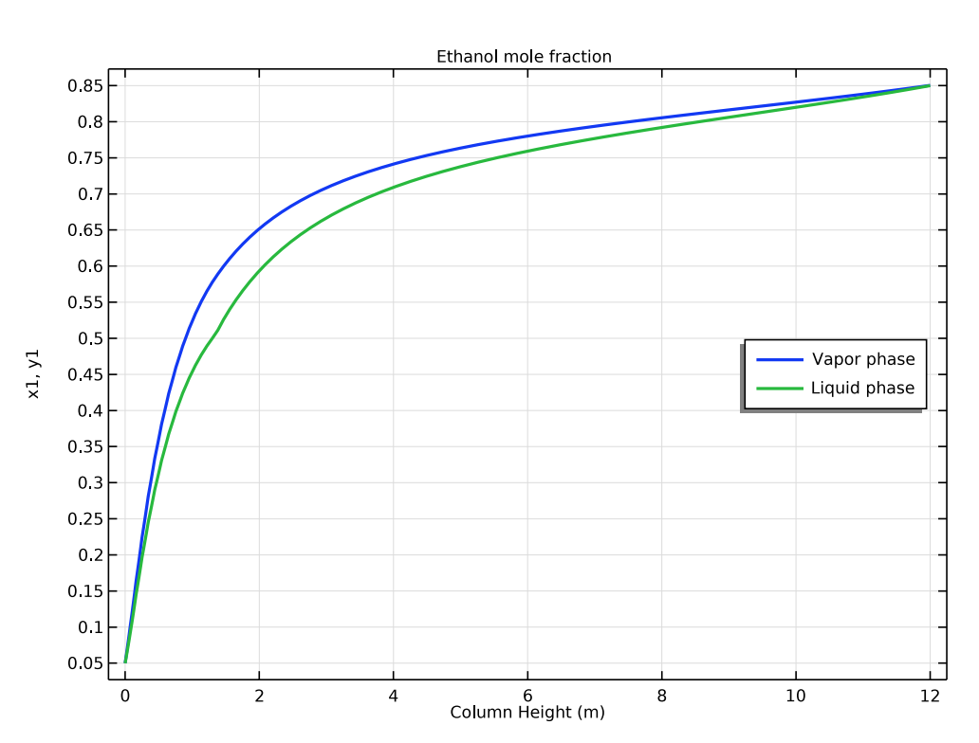
Model Results
Column designed to separate a 50 mole percent mixture of ethanol in water.
Resulted in a distillate of 85 mole percent ethanol and a bottoms of 5 mole percent ethanol.
The required heights found are Hs = 1.3m and H = 12m.

Slide 19
References
Chen, P.Y., CHBE426 Lecture on Introduction to Separation Processes. Presented at the University of Maryland, College Park, April 30, 2023.
Seader, J.D.; Henley, H.J.; Roper, D.K., Separation Process Principles, 4th ed. Wiley.

